Slide 1
Java Full Stack Training Program Date:21.11.2022
Guided by,
Mr. Ravindra Pidathala
Presented by,
1. Vaibhav Tyagi
2. Sudharsan R
3. Vikas A S
4. Shaffana Bibi S
5. Nagajothi A

Slide 2
CAB BOOKING SYSTEM
Domain: WEB DEVELOPMENT

Slide 3
Contents:
Introduction
Properties of System
Advantages
System Requirements
Software Requirements
Software Description
Module Description
Data flow Diagram
Architecture Diagram

Slide 4
Abstract
Cab Booking system is the motile system that allows managing the cab booking management task on an online platform
The system allows registered user login and new user are allowed to register on the application .The system helps in the management of the Users ,Drivers ,Bookings and the aspects related to them
The system allows users to book their cabs online, manage their bookings and cancel their bookings at any point of time
The users will get notified about the driver and his mobile number so they can communicate with them.

Slide 5
Introduction
This Online Cab Booking project deals with an online system designed for booking cabs as per the requirements of the customers at their convenience. Aim of the project is to develop a system that will increase efficiency and reduce the time and hassle of customers trying to book cabs.
It maintains the information and details about the Customer, Driver, Vehicle and Bookings.
We give ample options to book cab by entering details like their journey date and time, origin, pick-up point, destination and the drop-off point they need to reach.

Slide 6
Properties of System
The proposed Online Cab Booking project system ensures that the users can book the cab as per their requirements by logging on to the website.
The system allows users to book their cabs online, manage their bookings and cancel their bookings at any point of time.
Regular updates are provided to the customer so that they are aware of their bookings, driver details, and booking status.
This system is effective and saves time and cost for user.

Slide 7
Advantages
It enhances business processes since it makes use of internet technology to increase their profits.
The system acts as a 24/7 office due to its all-time availability.
It increases the efficiency of the system in offering quality services to its customers.
It’s user-friendly as they can book cabs from the comfort of their homes or offices.
It’s highly secure as it requires only a logged in person to book the cab which prevents misuse of their details by intruders.

Slide 8
System Requirements
Hardware Requirements
Processor : INTEL PENTIUM IV 2.6 Ghz
RAM : 4 GB
HardDiskDrive : 500 GB
KeyBoard : Standard 128 Keys
Monitor : 17” TFT MONITOR
Mouse : Logitech Serial Mouse

Slide 9
Software Requirements
Operating System : Windows 10 (or) 11
Frond end : Angular 8 Back end : Spring Boot
Database : MySQL

Slide 10
Software Description
Angular 8
Angular is an open-source, JavaScript framework written in TypeScript
Google maintains it, and its primary purpose is to develop single-page applications.
Angular is an opinionated framework which means that it specifies a certain style and certain rules that developers need to follow
As a framework, Angular has clear advantages while also providing a standard structure for developers to work with.
It enables users to create large applications in a maintainable manner.

Slide 11
Spring Boot
Java Spring Boot (Spring Boot) is a tool that makes developing web application and microservices with Spring Framework faster and easier
It is maintained by a company called Pivotal.
It provides Java developers with a platform to get started with an auto configurable production-grade Spring application.
With it, developers can get started quickly without losing time on preparing and configuring their Spring application.

Slide 12
MySQL
MySQL is an open-source relational database management system.
It is developed, distributed, and supported by Oracle Corporation
As with other relational databases, MySQL stores data in tables made up of rows and columns.
Users can define, manipulate, control, and query data using Structured Query Language, more commonly known as SQL

Slide 13
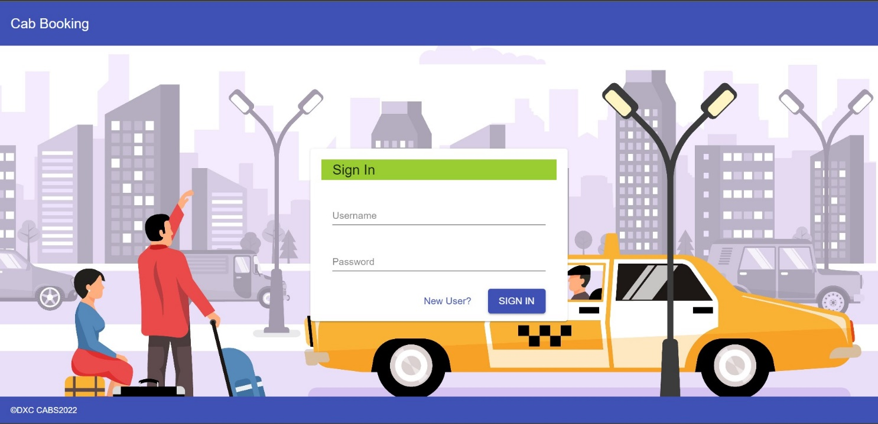
Modules Description
User/Driver Login
✓ In the Login page, the User/Driver has to enter the username and Password to Login into the Cab Booking system Menu page.

Slide 14
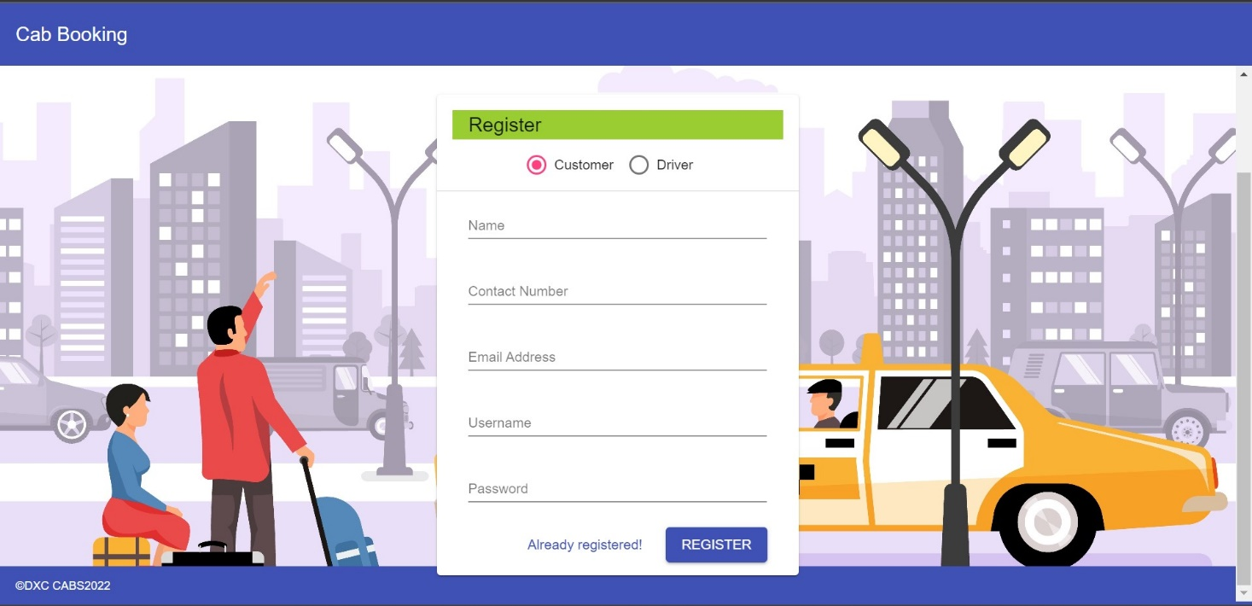
User/Driver Registration
In the Registration page, the User/Driver has to enter their details to get the login credentials and moves in to their respective menu pages
✓

Slide 15
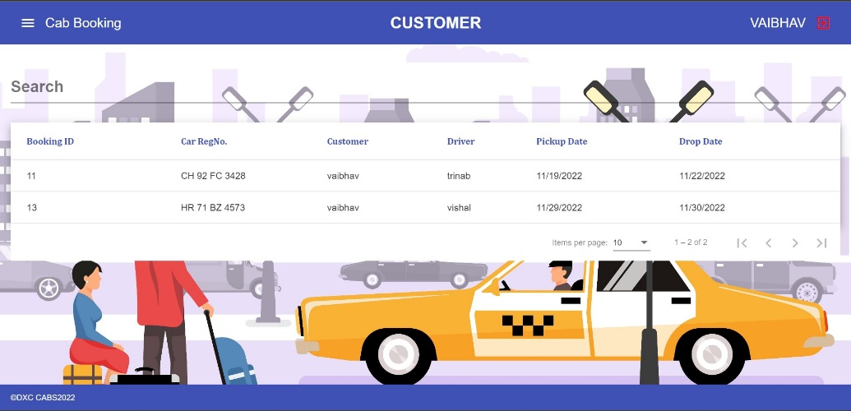
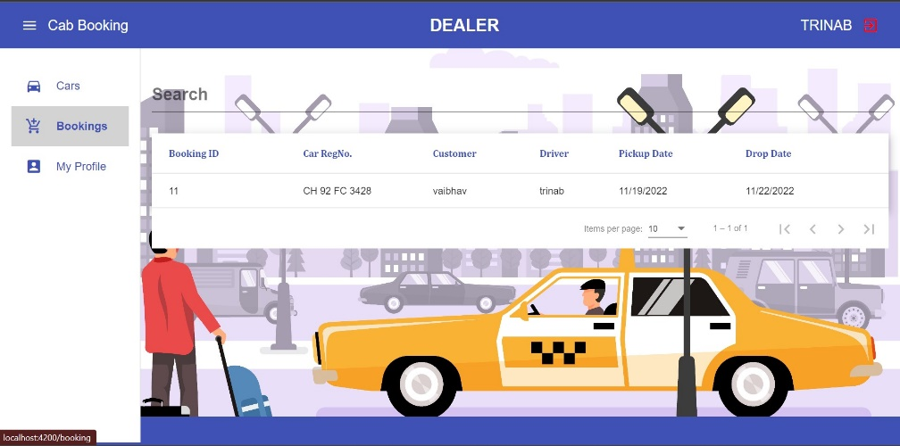
Booking Details
✓
In the Booking page, a user can book a cab and the User/Driver can see their booking details

Slide 16
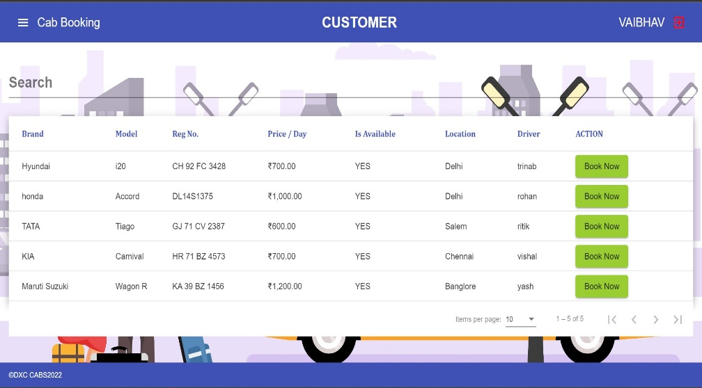
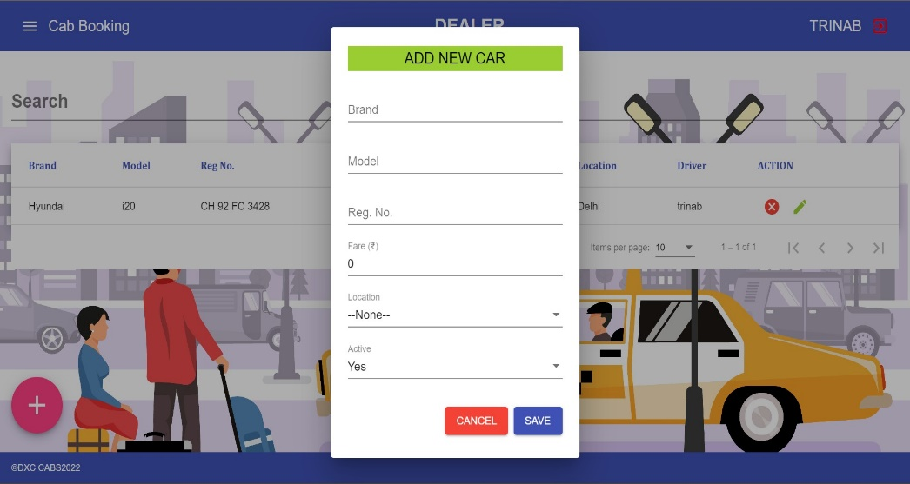
User/Driver Interface
✓
In the User/Driver interface, they can book cabs or add cabs.

Slide 17
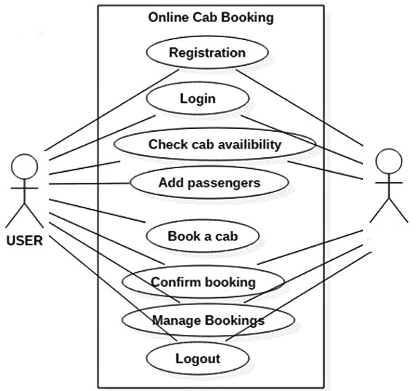
Data Flow Diagram
DRIVER

Slide 18
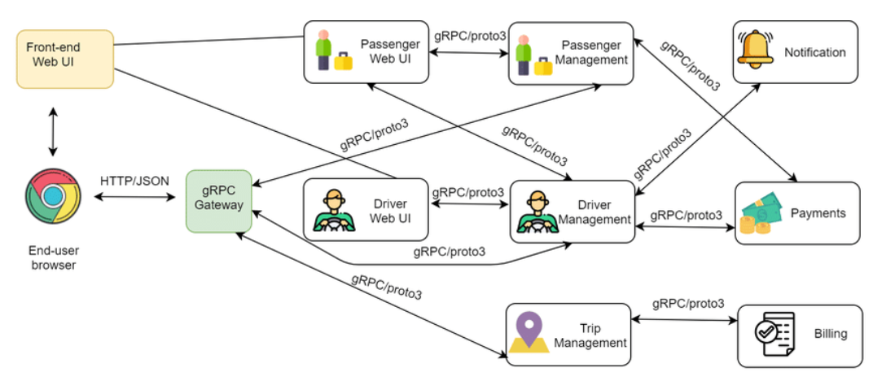
Architecture Diagram

Slide 19
Conclusion
In this project, we made attempt to effectively implement the technologies introduced in full stack java training.
As the result a user interface using angular 8 in front end and spring boot in back end along with my SQL database is implemented in the form of Cab Booking System with both driver/dealer and user entity.

Slide 20
THANK YOU

